Slide 1
Transforming software vendor business model
Instant Cloud migration for Windows apps
Mat Clothier, CTO, Cloudhouse Technologies

Slide 2
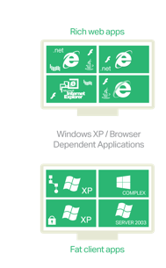
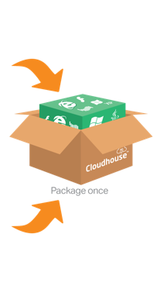

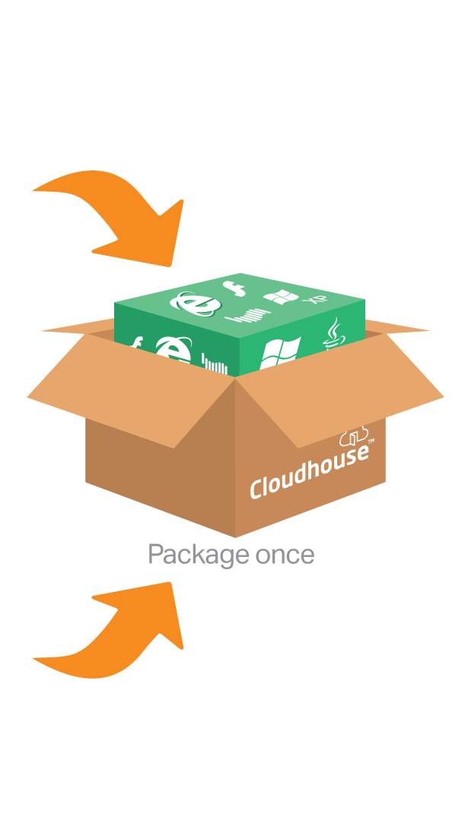
The fastest, cheapest and lowest risk way of getting to the Cloud
– Move to the Cloud and benefit from server-less computing and elastic scale and then iteratively develop with native technologies.
The fastest way get to the Cloud
Lower risks of the journey to Cloud native
Reduce the total cost of migrating apps to the Cloud
Decrease sales cycle (online trials, click-try-buy etc.)
Offer a true SaaS model
Add multi-tenancy to apps
Focus on developing new features, not on re-platforming
Stateless pool of RDS/Citrix
Serverless Computing
On-premise and/or deployed with some element of (possibly unsupported) RDS/Citrix
Apps can run on supported RDS/Citrix with 50% less servers and cost
Migrate to the Cloud to benefit from elasticity and iteratively develop with Cloud-native technologies

Slide 3

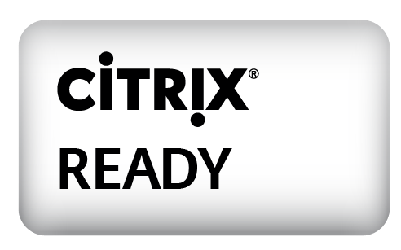

Slide 4

www.cloudhouse.com | info@cloudhouse.com | @CloudhouseTech

Slide 5
Think your classic Windows, custom or browser-based applications can’t run in Azure
THINK AGAIN!
www.cloudhouse.com
mat.clothier@cloudhouse.com

